Slide 1
The future of transportation and housing in greater Washington
Chuck Bean COG Executive Director Kanti Srikanth COG Deputy Executive Director for Metropolitan Planning Montgomery County Chamber of Commerce January 14, 2020

Slide 2
About COG
An independent, nonprofit association.
Brings area leaders together to address regional challenges.
Membership comprised of 300 elected officials from 24 local governments, the Maryland and Virginia state legislatures, and U.S. Congress.

Slide 3
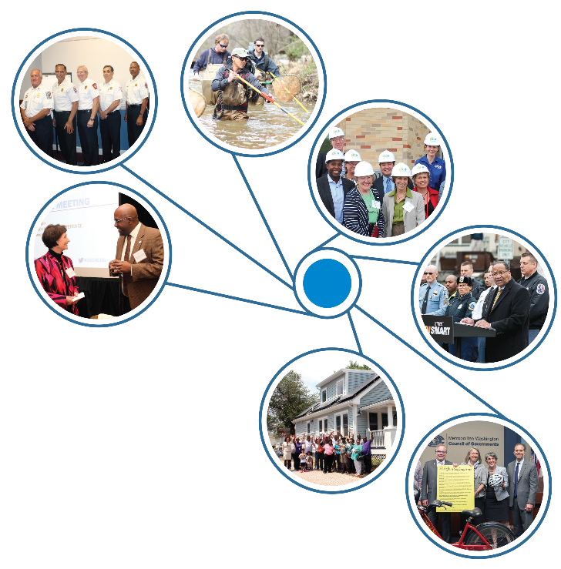
Hub for Regional Partnership
Elected officials
City and county managers
Police chiefs
Housing directors
Environmental experts
Transportation planners
Private, nonprofit partners
130+ professional COG staff

Slide 4
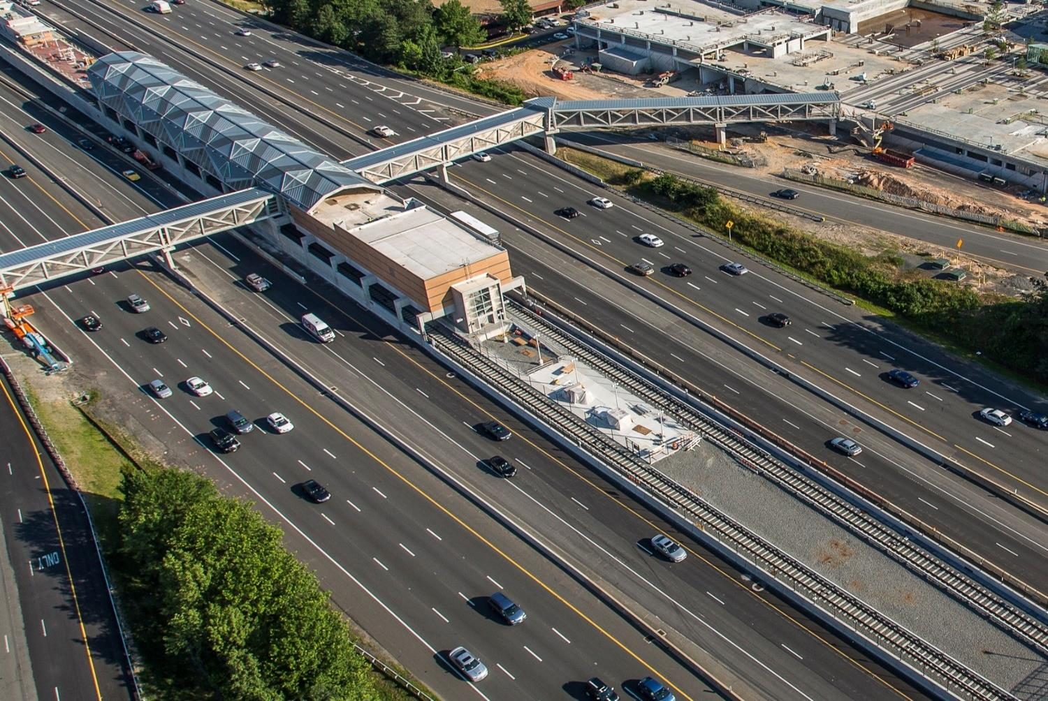
Home to the region’s Metropolitan Planning Organization (MPO)
Transportation Planning Board (TPB), one of 300+ MPOs in the nation.
Prepares programs, plans
the federal government must approve for the region to receive federal funds.

Slide 5
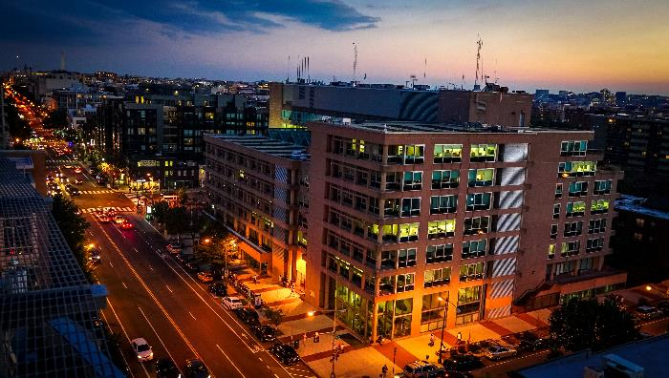
A Growing, Dynamic Region
Region ranks 5th of all metro areas for annual GRP.
Most educated in nation; leader in transit use, walkable communities.
Home to top talent and companies like: Marriott, Micron, Nestle, Yelp…

Slide 6
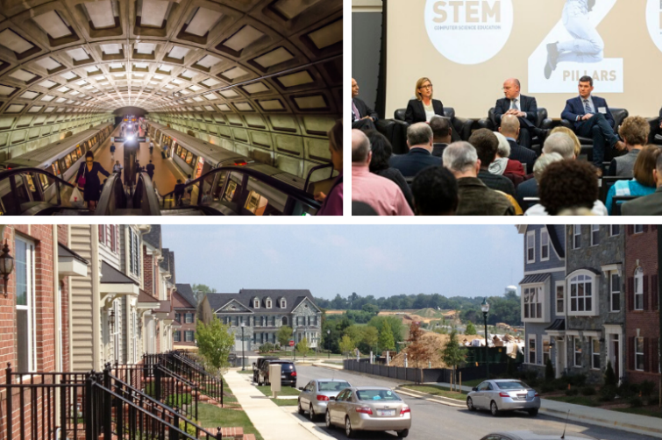
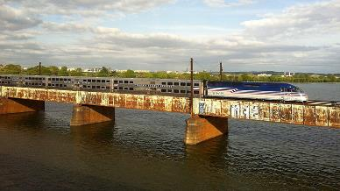
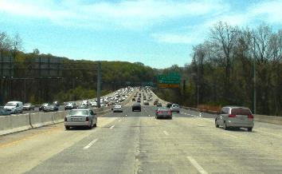
Regional Mojo
Amazon HQ2
Dedicated Metro funding, new Safty Commission
Legion, Long Bridges
TPB’s Visualize 2045
COG’s regional housing targets

Slide 7
Visualize 2045

Slide 8
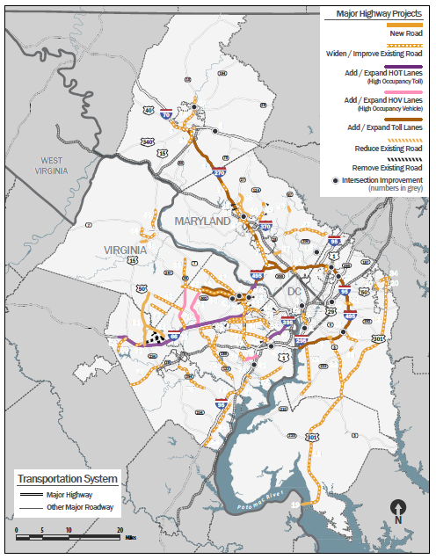
Visualize 2045
New long-range transportation plan for the region.
100+ major projects that expand or change the region’s highway or transit system capacity.
For first time, seven aspirational initiatives selected to create a higher-performing transportation system.

Slide 9
New Capacity in Visualize 2045
 | Roadway | Managed Lanes (subset of roadway) | High-Capacity Transit*
Existing | 17,048 lane miles | 436 lane miles | 292 miles
Added by Visualize 2045 | 1,388 lane miles | 461 lane miles | 124 miles
Total 2045 | 18,436 lane miles | 897 lane miles | 416 miles
* “High-Capacity transit” defined to include Metrorail, commuter rail, streetcar, light rail or bus rapid transit.

Slide 10
Performance Analysis Highlights
Growth will continue to place demand on the transportation network. The region will employ various elements to meet the demand/advance policies, however, challenges will continue to exist, though at levels less severe than identified in previous analyses.
  HOV will be more common than driving alone.
  Walk and bicycle trips ⬆ by 49% and transit trips ⬆ by 38%.
  The average person will drive 3% ⬇ in 2045 (miles).
  The region will experience ⬆ of 40% in transit and ⬆ of 5% in highway access to jobs, although some areas will still see declines.
  Total vehicle hours of delay ⬆ by 46% and avg. delay per trip ⬆ by 25%.

Slide 11

Seven Aspirational Initiatives
Bring jobs and housing closer together.
Expand bus rapid transit and transitways.
Move more people on Metrorail.
Increase telecommuting and other options for commuting.
Expand the express highway network.
Improve walk and bike access to transit.
Complete the National Capital Trail.

Slide 12
Housing Targets

Slide 13
Looking Back

Slide 14
Looking Back
“Catch up rate by 2030”

Slide 15
Looking Back
“Catch up rate by 2030”

Slide 16
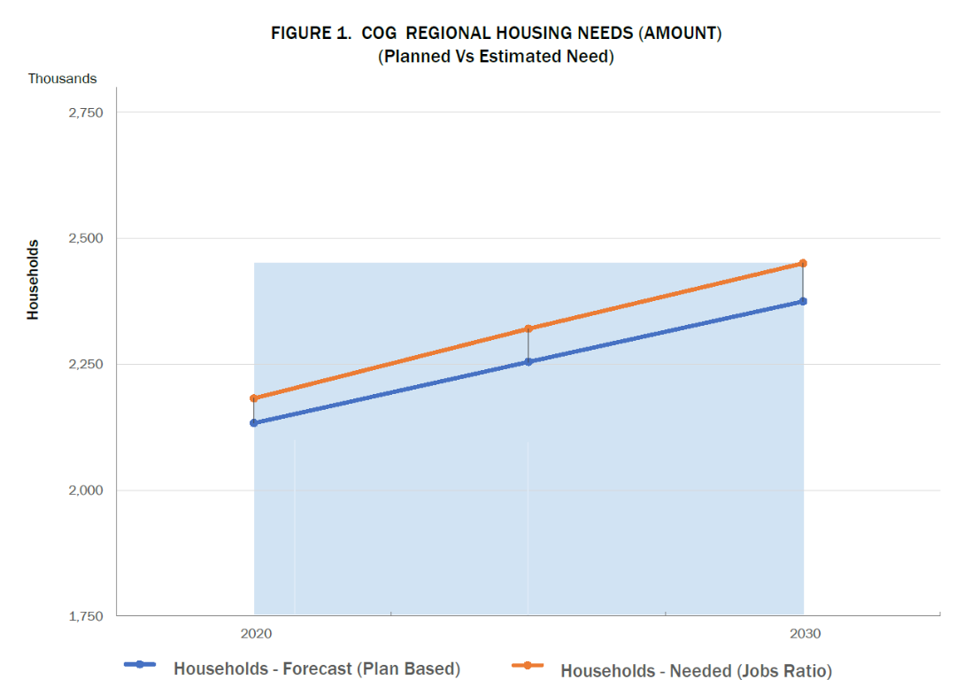
Housing Needs, 2020-2030
~320K Total New Units Needed
~75K
Shortfall
~245K
Forecast
16

Slide 17
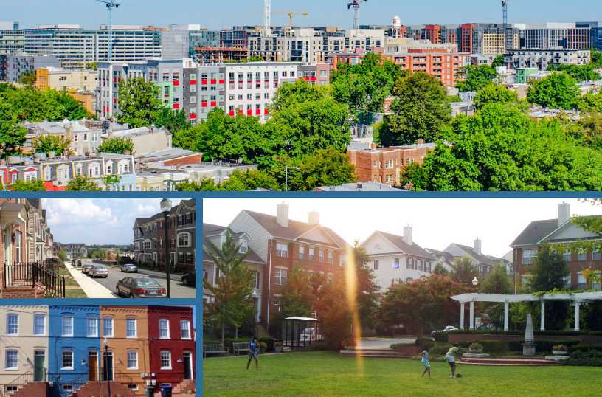
Housing: An Opportunity
Stronger economy.
Better performing transportation system.
Improved quality
of life resulting from greater affordability.

Slide 18
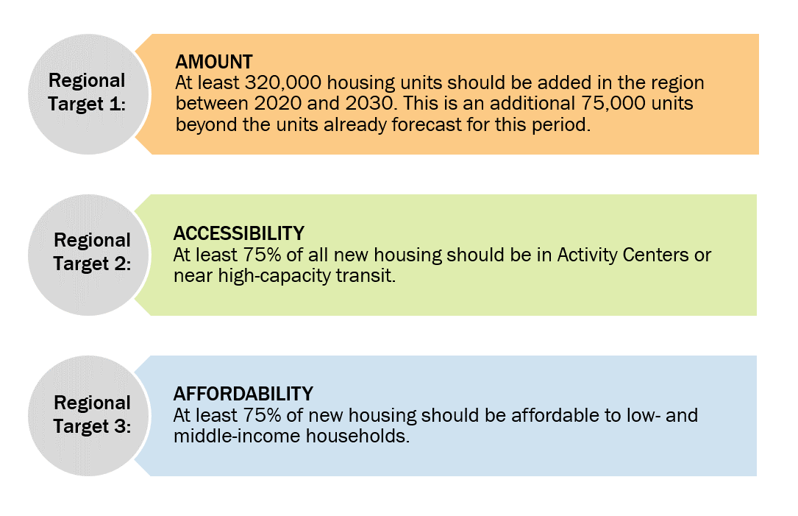
Regional Housing Targets

Slide 19
Looking Forward

Slide 20
Regional Projects/Analyses
I-66 – Express Lanes on & Transit Services
Legion Bridge/495/270
Numerous major/minor arterials capacity & bottleneck improvements
BRT services – VA and MD (CCT)
MARC/VRE service improvements
Additional rail tracks on Long Bridge
(TPB study on MARC/VRE run through service)
COG 2020 focus on optimizing land use around transit centers
  Metrorail, MARC, Purple Line, BRT
  Microtransit: Ride On Flex pilot

Slide 21
Regional Housing Targets

Slide 22
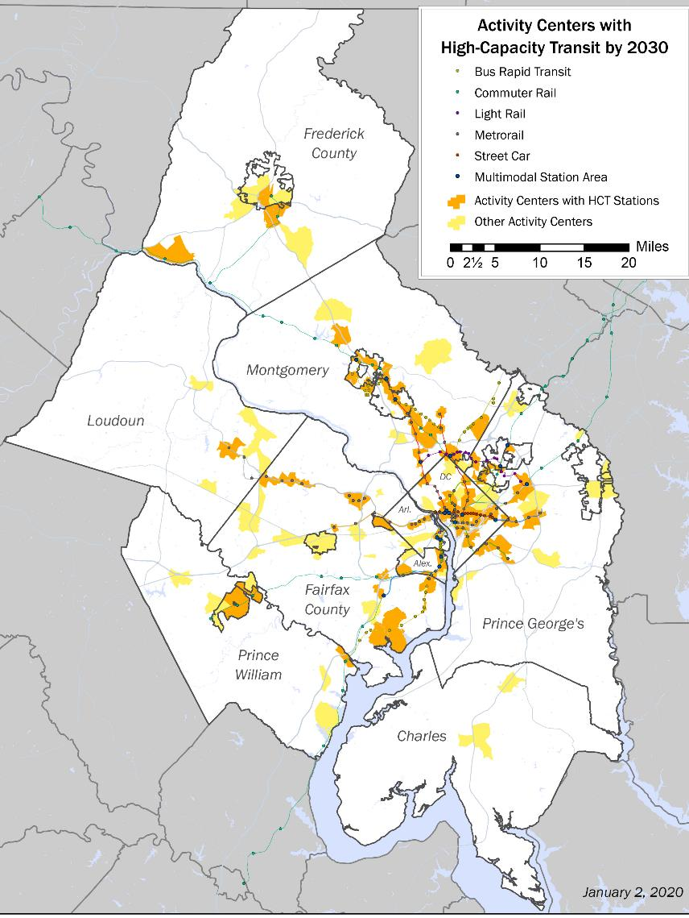
Accessibility: An Opportunity
Jobs target: 75% of new jobs located in Activity Centers.
Housing target: 75% of new housing located in Activity Centers/near high capacity transit (HCT).
To achieve housing target: optimize land use around 200+ HCT station areas, enhance transportation connectivity.
22

Slide 23
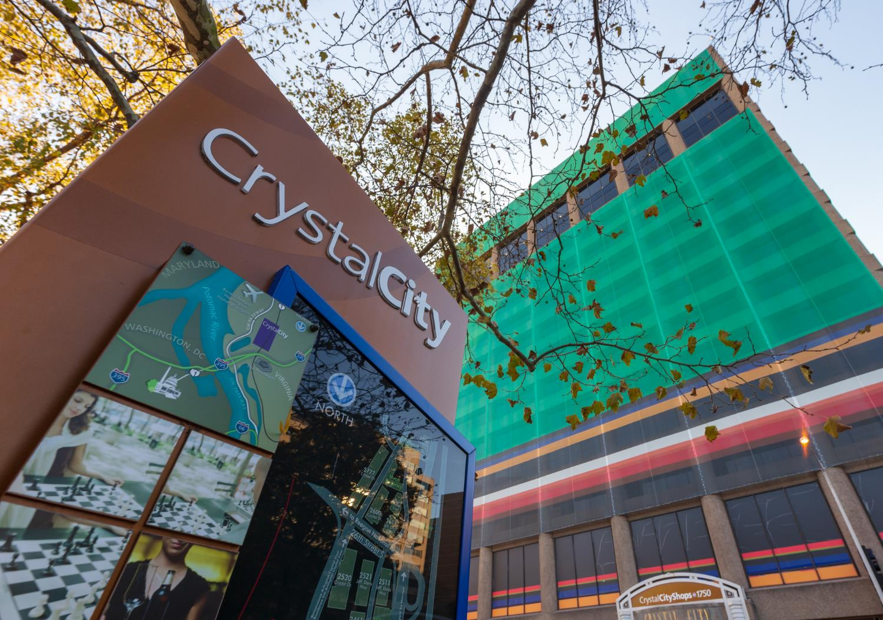
Why focus on High Capacity Transit in 2020?
Livability, sustainability, prosperity tied to mobility.
Region can maximize the mobility advantages of HCT systems.
Builds on billions in transportation investments.
Officials and developers note that transportation infrastructure can catalyze commercial development but pose challenges for producing housing at all affordability levels.

Slide 24
#1: HCT Station Area Locations
Develop an interactive, regional HCT station areas tool to:
  Identify and classify HCT stations in the region.
  Relate HCT stations to Activity Centers and Equity Emphasis Areas.
  Identify current and planned transportation investments.

Slide 25



#2: Understanding HCT Station Areas
Enhance the HCT station areas tool with:
  Current and forecasts demographics (Housing
  and Jobs).
  Regional Activity Center typology.
  Linkages to jurisdictional zoning and housing policies.

Slide 26



#3: Connectivity in HCT Station Areas
Examine options to improve connectivity within HCT station areas.
  Walkshed analysis.
  Micromobility analysis (bicycles, scooters).
  Microtransit analysis
  (shuttles, small feeder buses).

Slide 27
Chuck Bean COG Executive Director cbean@mwcog.org Kanti Srikanth COG Deputy Executive Director for Metropolitan Planning ksrikanth@mwcog.org | mwcog.org
777 North Capitol Street NE, Suite 300 Washington, DC 20002

